Slide 1





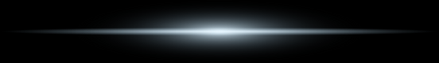


Top Hat
Dog
WELCOME TO
SMART
Car
Misinformation. Failures. Crises.
Our agents don’t play the game — they control the board.
START
MORE
Iron
SECURE
THE B-AGGIE
Notes:
30 secs

Slide 2



Risk
Risk
Risk
Risk
Casualties
Financial Loss
Infrastructure Damage
Public Safety
Cities Can’t Afford
to Roll the Dice
Past Failures
Japan Tsunami (2011) → evacuation delays due to uncoordinated alerts
Hurricane Harvey (2017) → stranded residents due to fragmented data
Today’s cities face a dangerous paradox: more data than ever — but less clarity when it matters most.
Delays, misinformation, and disconnected systems leave both leaders and civilians vulnerable — unable to see what’s real, where it’s happening, or what to do next.
Modern Challenges
IoT, tweets, weather, events — but no clear source of truth
Manual systems create decision bottlenecks
Cities need systems that think before things break
2
SECURE
THE B-AGGIE
See Appendix for Source Information

Slide 3
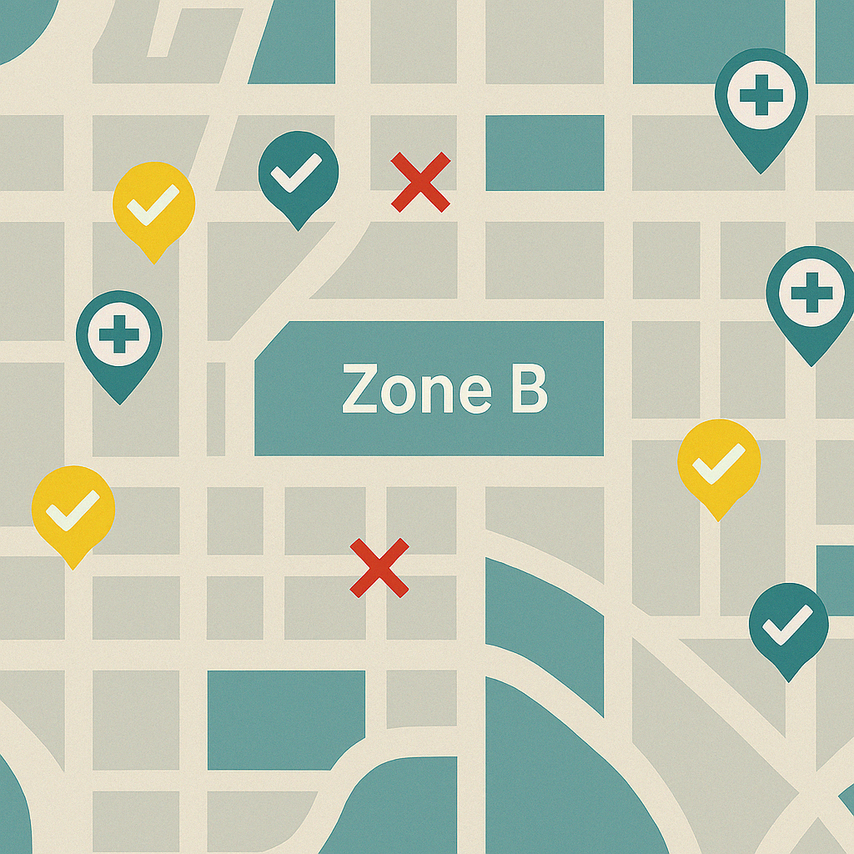





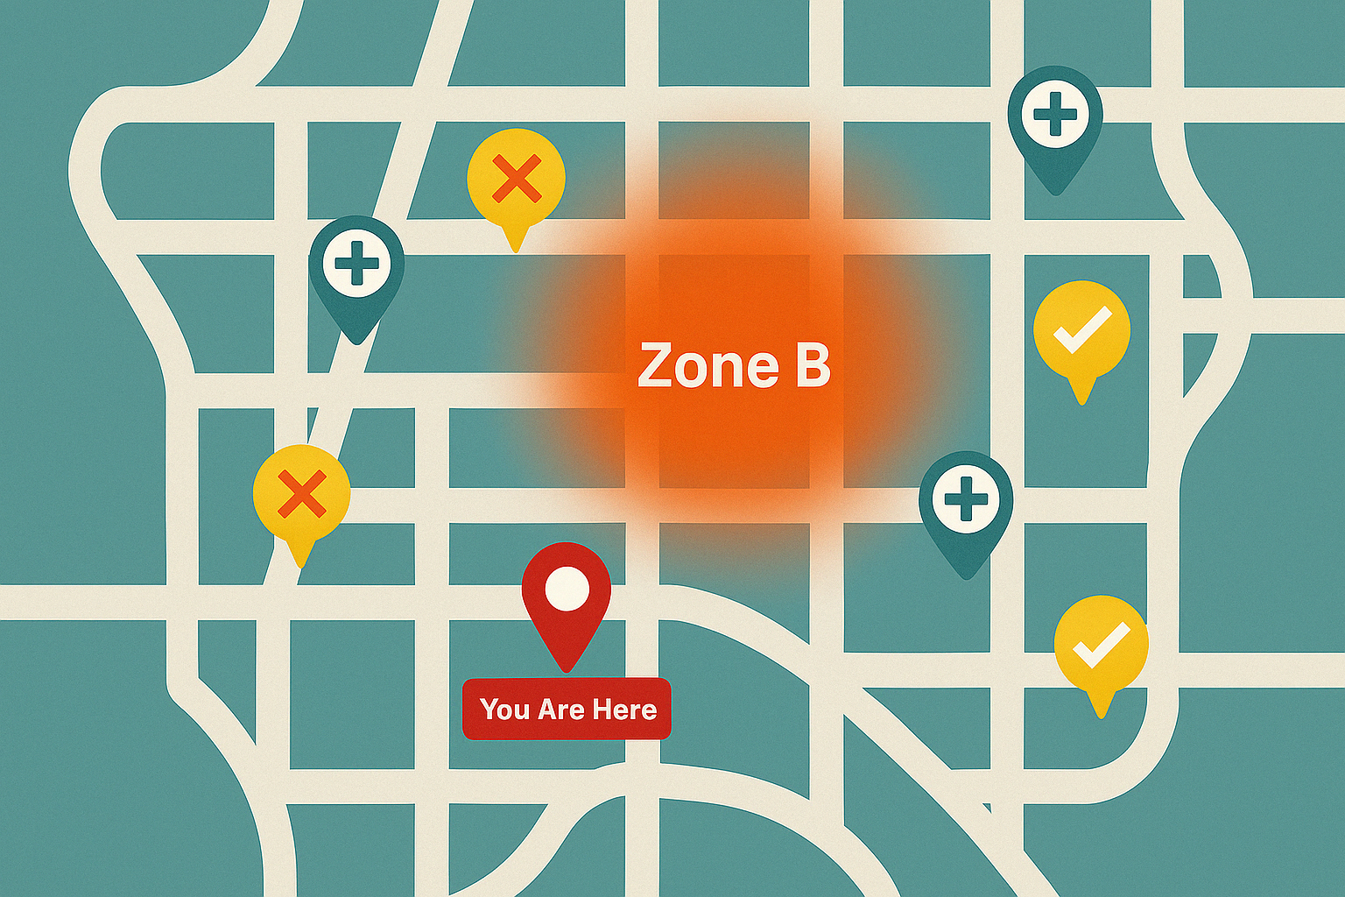



Our Solution
BEFORE
S.T.O.R.M*| AI-POWERED RISK AGENTS
Filter Out the Noise (Trust Signal Precision)
LLMs, GNNs, and LSTMs filter out fake tweets and faulty sensors by detecting spatial-temporal anomalies and misinformation patterns.
KPIs:
91% media classifier precision
Faulty sensor detection via anomaly modeling
AFTER
Make Quick, Reliable Decisions (Speed to Insight)
Parallel agents process live risk streams, delivering zone-level recommendations in under 10 seconds.
KPIs:
Agent latency: <10s
Enables real-time routing and response
Best Hospital
UCSF Memorial Hospital
3
SECURE
THE B-AGGIE
*S.T.O.R.M (Smart Tactical Operational Response Model)

Slide 4
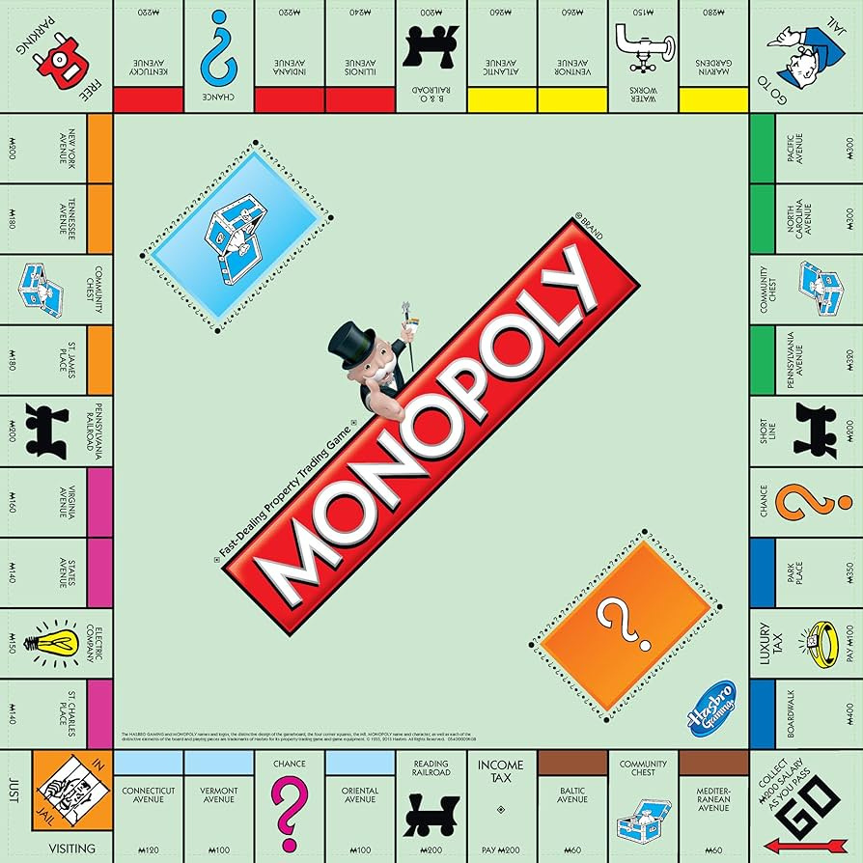


The “Top Hat”
Identifies misinformation and plays it smart.
INPUTS
LOGIC
OUTPUTS
Social Media
Real-time social media feed
Sensor Data
Status check
City Map Data
Map tweet locations
Content Assessment
Text classification
Sentiment analysis
Social Media Trust
User Behavior
Geography
Sensor Check
Trust Score
Range: 0 - 3
Sentiment Distribution
Negative, Positive, Neutral Counts
Spam Post Count
Top 10 suspicious posts
Predicted Precision = 91% on misinformation detection using labeled tweet data | View model logic in Appendix Slide 2
Notes:
1 min

Slide 5

The “Car”
Scans the board for threats — fast.
INPUTS
LOGIC
OUTPUTS
Sensor Readings
Faulty/inactive
Weather Data
Anomaly flag (top 5%)
City Map
Infrastructure + heatmap
Disaster Events
Zone-level severity + casualties
Sensor Risk Score
Faulty/inactive % over total sensors
Rolling Zone Aggregation
Compare live & historical baseline
Combined Risk
Weighted sum: severity, sensor risk, casualties
Sensor Risk Score
Normalized %
Avg. Severity
Mean of all past disasters in zone
Combined Risk Score
Final score per zone
Coverage: 50,000+ sensor readings grouped by zone/hour | View model logic in Appendix Slide 4
Notes:
1 min

Slide 6

The “Dog”
Alerts the city to cascading patterns no one else sees.
INPUTS
LOGIC
OUTPUTS
Filtering Noise
Faulty Sensor Data
Uncovering Hidden Patterns
Energy Data
Weather Data
Anomaly Detection
Unusual Data Changes
LSTMs
Sequential events
GNNs
Spatial risk considerations
Cascade Score
Weighted Sum of LSTM and GNN cascade risk (0-1)
Anomaly Flags
Sensor Readings
Energy Use
Weather
Detected anomalies roughly align with past events in 87% of validation cases| View model logic in Appendix Slide 3
Notes:
1 min

Slide 7


The “Iron”
Synthesizes all inputs and makes the final judgement.
INPUTS
LOGIC
OUTPUTS
Top Hat
Media Reliability
Dog
Cascade Risk
Car
Zone-Level Risk
Rule-Based Logic
Trust Score < 2 = Unreliable News
Risk Score > 0.5 = Dangerous Area
Cascade Risk > 0.5 = High chance of rolling consequences
Rolling Alert
10-minute status update window
Predicted Latency: Output generated in <10s after agent inputs | View model logic in Appendix Slide 5
Notes:
1:30 min

Slide 8




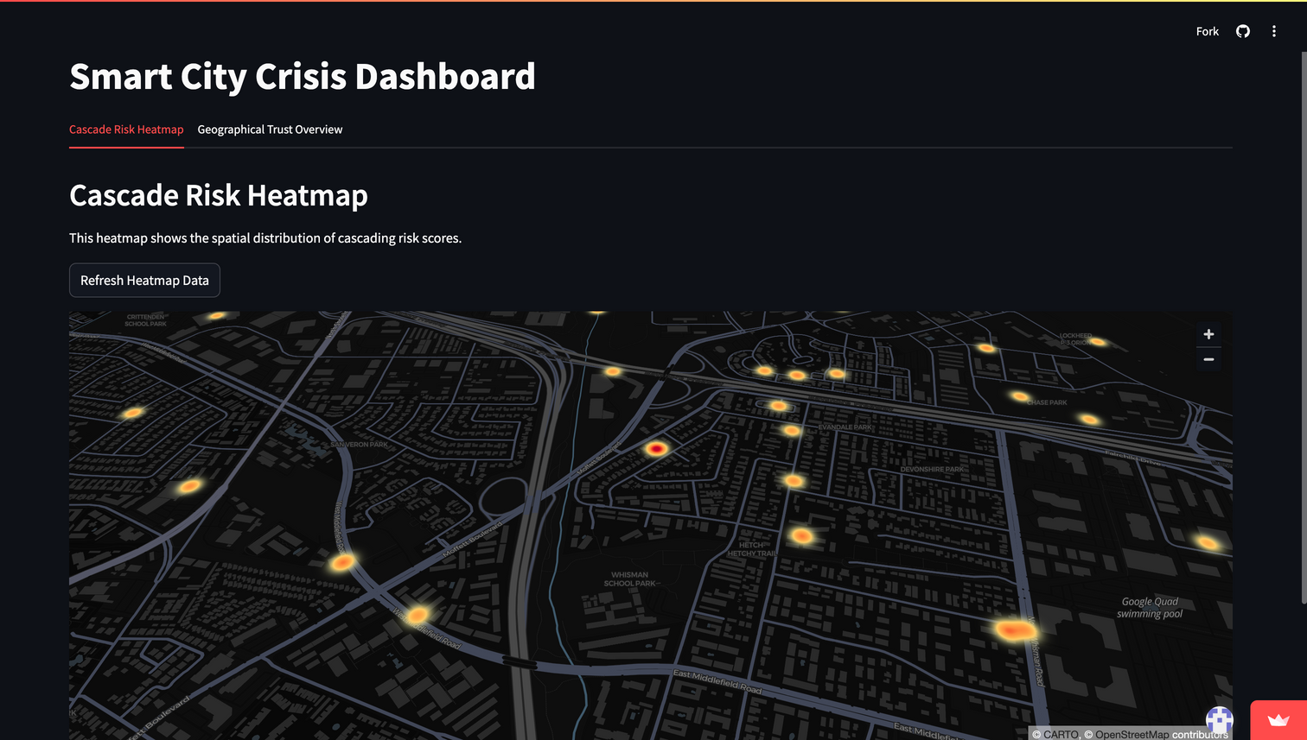
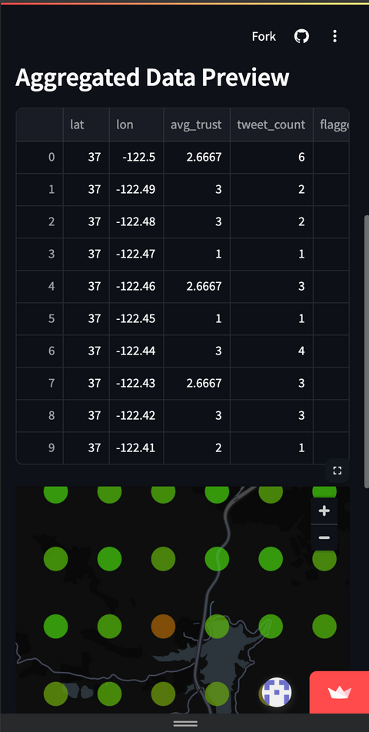



DEMO LINK
PROTOTYPE
From dashboard to dispatch, our system bridges the gap between data and action, guiding both civilians and officials through high-stakes moments.
9.8
SECONDS
RISK PREDICTION ACCURACY
SPEED TO INSIGHT
MISINFORMATION FILTERING PRECISION
I’m in the Nob Hill neighborhood, what should I do?
Plan to evacuate. Media coverage and sensor failures are spiking 5 miles from you.
If you need medical attention, UCSF is 0.5 miles away.
8
SECURE
THE B-AGGIE

Slide 9

The Next Roll
Advancing the board through smarter systems and scalable upgrades:
Data Enrichment
Real - World Impact
Add real-time data from 911, utility, or health systems.
→ Boosts accuracy + zone-specific action.
Making safety accessible.
Every resident gains reliable, real-time awareness of risks around them — enabling faster, smarter decisions when it matters most.
→ Empowers civilians. Saves lives. Builds trust.
Deployment Optimization
Deploy STORM in live dashboards with SMS alert triggers.
→ Low-latency response, built for real cities.
9
SECURE
THE B-AGGIE

Slide 10
APPENDIX
Note: Metrics and KPIs are based on static hackathon data and reflect ideal evaluation logic — not yet validated on real-time or scaled inputs.
SECURE
THE B-AGGIE

Slide 11
CODE LINK
Phase 1
Cardiff-NLP pretrained model to detect rising negative sentiment
Sentiment Analysis
Phase 2
BERT-based pretrained model to detect fake news
Fake News Analysis
Social Media Trust Score
Phase 3
Trust Scoring
(0 - 3)
User Behavior (+1)
Geographic validity (+1)
Sensor confirmation (+1)
How reliable are social media posts?
2 | APPENDIX

Slide 12
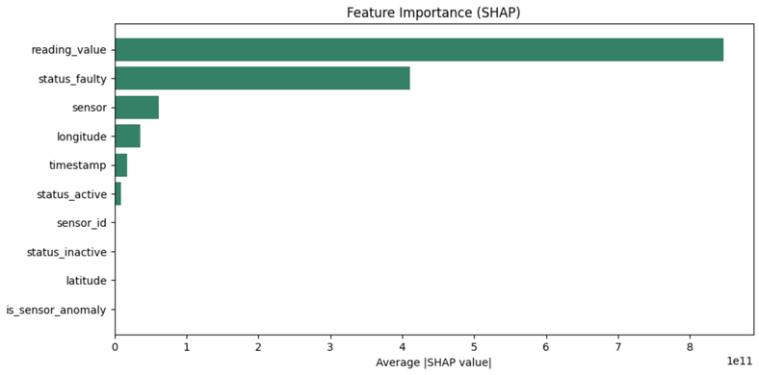
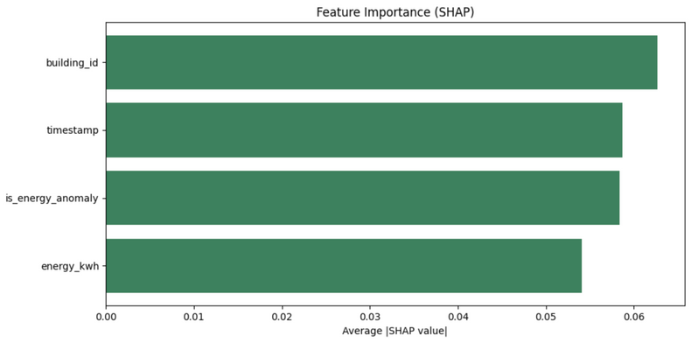
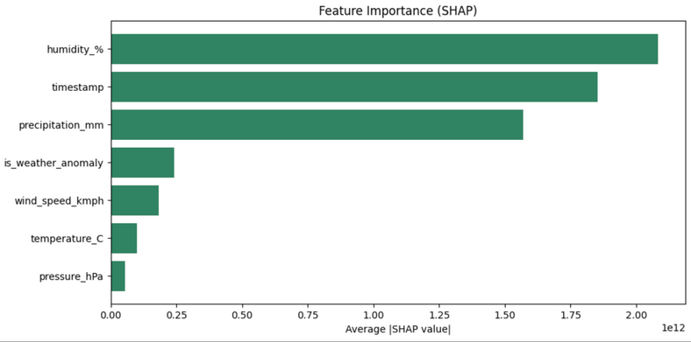
CODE LINK
Sensor Anomalies
Cascade Prediction: Anomaly Detection
Reading, Sensor Status
Energy Anomalies
Location +
Timestamp
Each graph represents the importance of certain features in determining & detecting anomalies.
Weather Anomalies
Weighted Cascade Risk = 0.6*[LSTM Risk Score] + 0.4*[GNN Risk Score]
Humidity + Precipitation
3 | APPENDIX

Slide 13
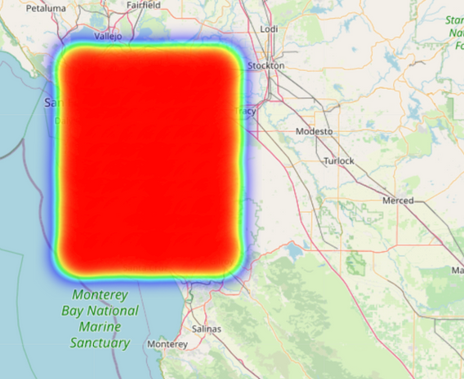
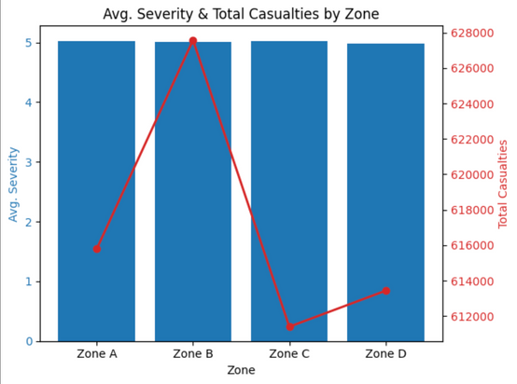
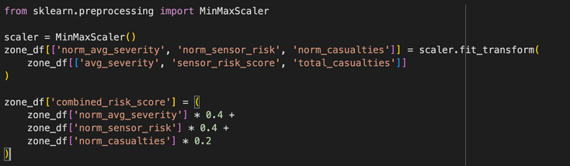
CODE LINK
Element 1
Sensor Risk Heatmap
Zone Risk Score Prediction
Element 2
Severity & Infrastructure
Each elements shows how sensor activity, disaster severity, and infrastructure gaps contribute to zone-level risk scores.
Element 3
Values normalized using MinMaxScaler
Combined Risk = 0.4(Avg Severity ) + 0.4(Sensor Risk Score) + 0.2(Total Casualties)
Combined Risk Calculation
4 | APPENDIX

Slide 14
General Risk
A risk score > 0.5 indicates a disaster-prone area
General Risk
(0 - 1)
Iron Model Recommendation System
Cascade Risk
A risk score > 0.5 indicates a high likelihood of cascading effects
Cascade Risk
(0 - 1)
Example Decision + Alert
Media Validity
A trust score < 2 indicates social media is unreliable
Rule-based reasoning and decisions using real-time and rolling averages.
Trust Score
(0, 3)
5 | APPENDIX

Slide 15

Sources Referenced
Flood Net NYC (real-time urban flood monitoring)
Countering False Information on Social Media in Disasters and Emergencies, March 2018
Learning from Megadisasters: A Decade of Lessons from the Great East Japan Earthquake
Smart City Integration: How IoT is Reducing Emergency Response Times and Saving Lives - IEEE Public Safety Technology Initiative
LSTM and ResNet18 for optimized ambulance routing and traffic signal control in emergency situations | Scientific Reports
6 | APPENDIX

